Slide 1
Nutrient Cycles Project

Slide 2
Diagram all the stages of all three cycles in one poster, in one ecosystem.
Group | Ecosystem | Cause | Effect – Disruption: | Benefit: | Solution:
1 | Cannon Beach, Oregon | Clear Cutting
2 | Appalachian Mountains | Coal mining
3 | Mississippi River | Agriculture: Crop fertilizers.
4 | Phoenix, Arizona | Vehicle/ Industrial exhaust
5 | Flint, Michigan | Lead-lined pipes
6 | Lake Okeechobee, Florida | Agriculture: Animal Manure and Animal Feed Fertilizer
7 | New York City, New York | Urban Sprawl
8 | Pavillion, Wyoming | Hydraulic fracturing (“fracking”)

Slide 3
My Ecosystem: points 0/10/16/20 | Search and find a suitable “landscape” picture for the ecosystem your group is assigned. Use this a backdrop for a shared PowerPoint slide (share through google slides). You and your group will be working from this in class or at home. Diagram EACH CYCLE completely on top of the background landscape (all stages you defined in your notes). It would probably be best to split up and give each person a different cycle to diagram and label. The last person could help and research particulars for the project. Include…
Cause: | What is the cause listed on the board for your group? _______________________________________
Effects/ Disruption: points 0/5/8/10 | Which cycle is effected most? (if there is more than one, choose which you’ll focus on) What is the disruption to the cycle? Which stage of this cycle is effected most? What is the molecule, participant, pollutant added or subtracted from the ecological equation? How is life specifically impacted by this?
Benefit: points 0/5/8/10 | Why would humans do the activity that causes this disruption? What benefit does the general public get out of it? How do YOU benefit from this activity? Be honest. Not everyone agrees these disruptions are immoral.
Solution points 0/5/8/10 | Is this problem fixable? Are there efforts in place addressing this? How could we fix the problem What are simple steps we could take to undo the disruption? What is something YOU can do to help reverse this issue? How long will it take to complete the fix?

Slide 4
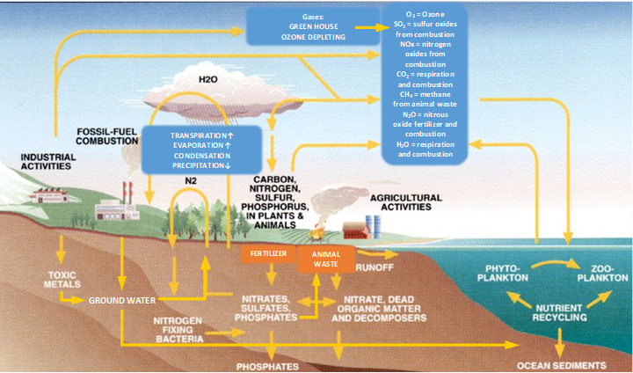
PRECIPITATION
EVAPORATION

